Slide 1
AI FUNDAMENTALS
Madison College
Week 04
Large Language Models (LLMs)
Notes:
This lecture covers the basics of Large Language Models (LLMs), including what they are, how they differ from traditional models, and the principles behind their design and operation.

Slide 2

TOPICS
Introduction to Large Language Models (LLMs)
Architecture and Construction of LLMs
Functionalities of LLMs
Data Requirements for LLMs
Model Training Processes
Resources Needed for LLMs
Notes:
First, we'll explore what makes Large Language Models (LLMs) unique.
We'll discuss a few examples like OpenAI's GPT and break down the technology behind them in an easy-to-understand manner.
This includes their architecture and construction, the functionalities they offer, the data requirements, the processes involved in their training, and the computational resources needed for their operation.

Slide 3

What are Large Language Models?
Definition
LLMs vs Traditional Models
LLMs vs Generative Models
Notes:
Definition of Large Language Models (LLMs): A large language model (LLM) is a type of artificial intelligence that can understand and generate human-like text. LLMs are part of "deep learning," a type of machine learning that uses artificial neural networks. These networks are specifically designed to understand and generate text like humans do. LLMs are trained on huge datasets, sometimes as large as petabytes, which include text from books, articles, websites, and social media. This extensive training helps them understand context and language subtleties, allowing them to produce coherent and contextually appropriate text responses.
LLMs are used in many familiar places, from powering smart responses in digital assistants like Alexa, to filtering emails, to suggesting content on streaming platforms.
Distinguishing LLMs from Traditional Models: Traditional models handle specific, narrow tasks. For example, a keyword-based search engine looks for specific words in documents, and a simple rule-based chatbot responds to specific commands with preset answers. These traditional models usually have a limited understanding of context because they rely on explicit programming for each task.
In contrast, LLMs can handle a wide range of language tasks more dynamically. They use machine learning to understand and generate text. LLMs are trained on large amounts of text from various sources, helping them grasp context and language nuances. This enables them to perform complex tasks such as summarizing articles, translating languages, or creating original content. LLMs can adapt to new tasks with minimal additional programming, making them much more flexible and capable than traditional models.
LLMs vs. Generative Models: LLMs are a type of generative model with a special process. First, they are pretrained on a very large dataset to understand general language patterns. After that, they are fine-tuned for specific purposes using smaller datasets. This makes them highly versatile and able to handle a variety of tasks effectively.

Slide 4

Applications of LLMs in Daily Life
Digital Assistants (Google Assistant, Bixby, Siri, Alexa)
Email Automation (Smart Reply)
Content Recommendations (Netflix, Spotify)
Notes:
Large Language Models (LLMs) are integrated into many aspects of our daily lives.
Digital assistants like Alexa, Google Assistant, and Siri use LLMs to understand and respond to your questions.
In email applications, features like Gmail’s Smart Reply, which suggests quick responses, are powered by LLMs analyzing the content of your messages.
Additionally, when using services like Netflix and Spotify, the shows and music recommended to you are often the result of LLMs analyzing your preferences and viewing habits.

Slide 5
Some LLM’s
GPT-4o by OpenAI
BERT by Google
RoBERTa by Meta
T5 by Google
BART by Meta
BLOOM by BigScience
ERNIE by Baidu
DeBERTa by Microsoft
ALBERT by Google
LLaMA by Meta
Notes:
ChatGPT is one of many LLMs developed worldwide and is perhaps the most well-known example.
However, it is just one of many others.
For example, Google's BERT helps understand the context of search queries, and Facebook's BART is designed to better understand social media content.
Each model has unique strengths for specific language tasks, which is an important feature for advancing AI capabilities.
The next 3 slides will quickly introduce three LLM’s that you may be familiar with.

Slide 6

GPT Series by OpenAI
Introduction to GPT series
Generated Pre-trained Transformer
Emphasis on GPT-4o
Developed by OpenAI
Notes:
GPT Series: The Generative Pre-trained Transformer series, better known as GPT, developed by OpenAI.
Highlighting GPT-4o: This series advanced AI capabilities with GPT-4o being the latest version. GPT uses deep learning to perform various language tasks.
Impact of GPT-4: It shows how LLMs can imitate human writing in different styles and contexts, demonstrating what AI can do in understanding and generating complex texts.

Slide 7
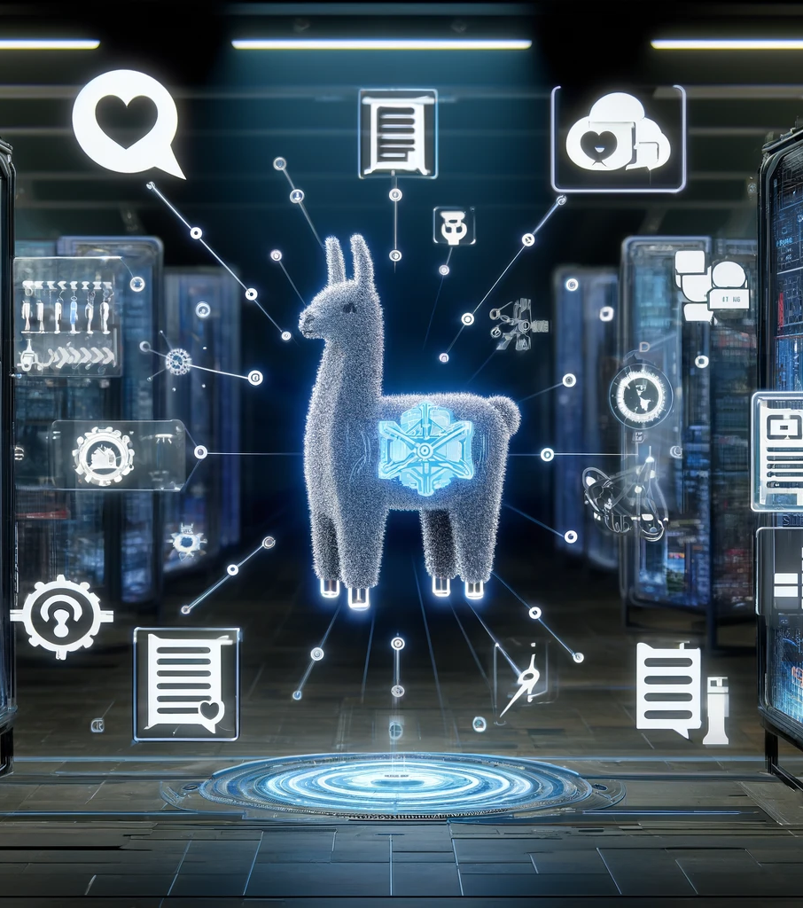
LLaMA by Meta
Developed by Meta
Versatility in language tasks
Used in commercial and academic sectors
Notes:
Meta's LLaMA: Meta's LLaMA model is designed to handle a wide range of language processing tasks.
Capabilities and Applications: The model is versatile, making it useful in both commercial and academic settings. Its ability to adapt to various language tasks allows it to perform well in different areas, showing the practical applications of modern LLMs.

Slide 8

BLOOM by Hugging Face
By Hugging Face
Multilingual capabilities
Open-source and accessible
Notes:
(Introduction to BLOOM: Next, we turn our attention to Hugging Face's BLOOM model. BLOOM stands for BigScience Large Open-science Open-access Multilingual Language Model.
Focus on Accessibility and Collaboration: This model is notable for its multilingual capabilities and open-source nature, which encourages global collaboration and accessibility. BLOOM's design makes advanced language processing tools available to a broader audience worldwide.

Slide 9

Transformer Architecture
Where did transformers originate?
Understanding Transformer Architecture
Importance of Transformers
Notes:
Transformers origin story: Before 2017, language models struggled to understand and generate text effectively. When Google introduced the transformer architecture in 2017, the performance of LLM’s greatly improved.
Understanding Transformer Architecture: The key innovation in transformers is the use of self-attention mechanisms. These mechanisms allow the model to consider the importance of each word in a sentence relative to every other word, enabling it to understand context and relationships between words more effectively. Instead of reading word by word in order, the model can focus on different parts of the sentence simultaneously.
For example, in the sentence "The cat sat on the mat," the model understands that "the mat" is related to "sat on" and not just isolated words. Because traditional models processed sentences word by word they often missed the bigger picture. In contrast, transformers process all words at once, making them faster and better at capturing context.
Importance of Transformers: The flexibility and efficiency of transformer architecture improves LLM’s by allowing them to process and generate language with high accuracy and speed over a wide range of language tasks, such as translation, summarization, and question answering.

Slide 10
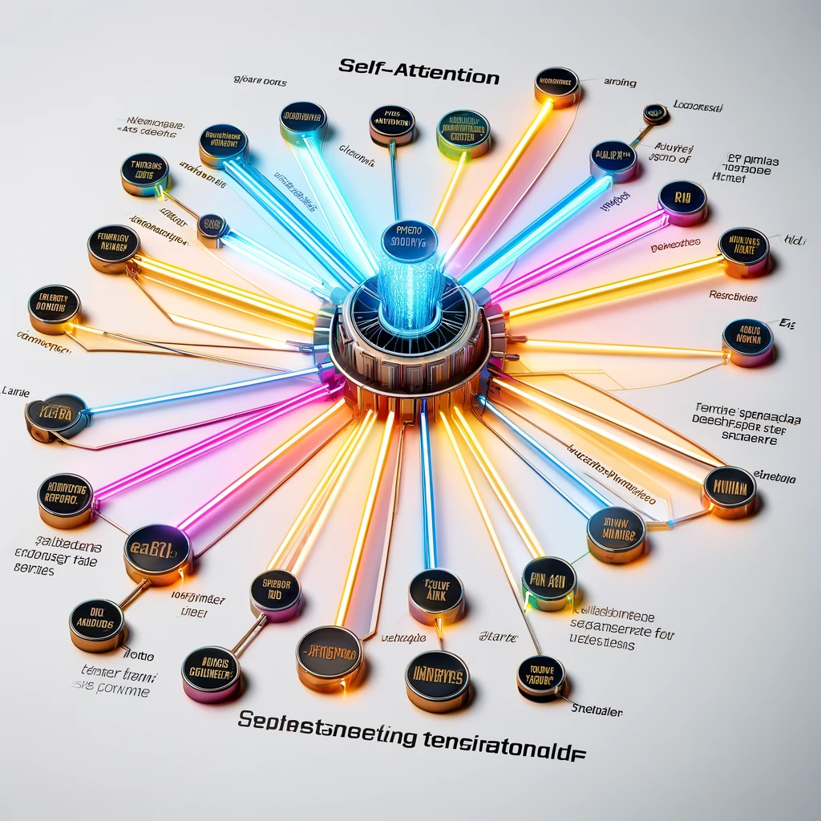
Attention Mechanisms
Cornerstone of LLM processing
Facilitates context understanding
Enhances text relevance
Notes:
Exploring Attention Mechanisms: Building on the Transformer architecture, a cornerstone in the operation of LLMs is the attention mechanism. This feature allows LLMs to focus on different parts of the input data more dynamically than traditional static models.
Functionality of Attention Mechanisms: By understanding which parts of the data are more relevant to the task at hand, attention mechanisms enhance the model's ability to generate coherent and contextually appropriate outputs. This is essential for tasks that require a deep understanding of language nuances, such as answering questions or summarizing long documents.
Impact on LLM Performance: The integration of attention mechanisms has led to significant improvements in how LLMs process and generate text, ensuring that the output is not only accurate but also highly relevant to the context. This has enhanced the effectiveness of LLMs in various applications, making them more reliable for complex language tasks.

Slide 11

ILLUSTRATING ATTENTION MECHANISMS
Classroom Analogy
Attention Mechanisms in LLMs
Notes:
Classroom Analogy: Imagine you are in a classroom where the teacher is explaining a complex topic. You don't just focus on the last sentence they said; instead, you remember key points from the entire lesson to understand the full context.
Attention Mechanism in LLMs: Similar to a student recalling important parts of a lesson, an attention mechanism in a Large Language Model focuses on significant information throughout a sentence. For example, understanding that a "CPU" is the "brain of the computer" and how it "processes instructions" helps the model provide accurate and context-aware responses.

Slide 12

NLP Techniques
Tokenization
Stemming
Lemmatization
POS Tagging
Parsing
Sentiment Analysis
Notes:
From Attention Mechanisms to NLP Techniques: Now that we've seen how attention mechanisms help models understand context, let's explore some specific Natural Language Processing (NLP) techniques that use these mechanisms. These NLP techniques include tasks such as text classification, language translation, sentiment analysis, and more. Each technique helps the model focus on relevant parts of the input to produce accurate and meaningful outputs.
Understanding NLP Techniques:
Tokenization:
Breaking down text into smaller units like words or phrases.
Example: The sentence "Natural Language Processing is fascinating" becomes ["Natural", "Language", "Processing", "is", "fascinating"].
Importance: Converts text into manageable units for analysis and machine learning.
Stemming:
Reduces words to their root form by removing prefixes and suffixes.
Example: The words "running," "runner," and "ran" might all be reduced to "run."
Consideration: Can sometimes produce non-dictionary forms, like "runn" instead of "run."
Lemmatization:
Converts words to their base or dictionary form.
Example: "Running," "runner," and "ran" are all converted to "run."
Advantage: Ensures more accurate transformations compared to stemming.
POS Tagging (Part-of-Speech Tagging):
Labels each word in a sentence with its part of speech, such as noun, verb, adjective, etc.
Example: In the sentence "The quick brown fox jumps over the lazy dog," each word would be tagged: [The/DT quick/JJ brown/JJ fox/NN jumps/VBZ over/IN the/DT lazy/JJ dog/NN].
Parsing:
Analyzes the grammatical structure of a sentence to understand its syntactic relationships.
Example: In the sentence "The cat sat on the mat," parsing identifies: "The cat" as the subject, "sat" as the verb, "on the mat" as the prepositional phrase describing the location.
Sentiment Analysis:
Determines the sentiment or emotion expressed in a text.
Examples: "I love this product!" (positive sentiment), "I hate this product" (negative sentiment).
Usage: Widely used in customer feedback analysis and social media monitoring.
These techniques are essential in various NLP applications, including text analysis, machine translation, information retrieval, and more.

Slide 13

LLM Layers and Roles
Layered Structure of LLMs
Function & Interaction of Layers
Significance of Layered Processing
Notes:
With an understanding of various NLP techniques, it's important to see how these techniques are integrated within the layered structure of Large Language Models (LLMs).
Layered Structure of LLMs: Large Language Models are composed of multiple layers, each designed to handle different aspects of language processing. This multi-layered approach allows the model to build a comprehensive understanding of the input by gradually refining the information at each stage.
Function and Interaction of Layers: As data moves through these layers, it is processed incrementally. Each layer focuses on specific tasks: some layers might detect basic features like words and phrases, while others handle more complex structures like syntax and semantics. By the time the data reaches the final layer, the model has built a detailed representation of the input, enabling it to generate accurate and contextually appropriate responses.
Significance of Layered Processing: This structured processing is crucial for tasks that require precise language understanding, such as translation and creative writing. The layered design ensures that each aspect of the language is carefully analyzed and interpreted. This method enhances the model's ability to manage complex linguistic patterns, leading to more detailed and accurate outputs.

Slide 14

Data Requirements and Sourcing
Diversity of training data
Ethical data sourcing
Notes:
Understanding the layered structure and roles within Large Language Models (LLMs) leads us to explore the data requirements and sourcing that make these models effective.
Diversity of Training Data: To perform well across a wide range of language tasks, LLMs require diverse training data. This means the data must come from various sources, including books, articles, websites, and social media. The diversity ensures that the model can understand and generate text in different contexts, styles, and tones. For example, training data might include scientific papers, literary works, everyday conversations, and technical manuals. This variety helps the model generalize better, making it more versatile and effective in handling different language tasks..
Ethical Data Sourcing: Ethical data sourcing involves ensuring the data collected respects privacy, copyright, and consent. Data must be collected from publicly available and legally permissible sources, with efforts to anonymize personal information to protect privacy. Including diverse voices and perspectives in the training data is essential to avoid biases. Bias in data can lead to unfair or inaccurate outcomes, so it's important to have representation from different demographics, cultures, and viewpoints. Transparent data sourcing practices help build trust and ensure the responsible development and use of LLMs. By addressing these ethical considerations, we can create models that are fairer and more inclusive, contributing to more equitable AI applications.

Slide 15
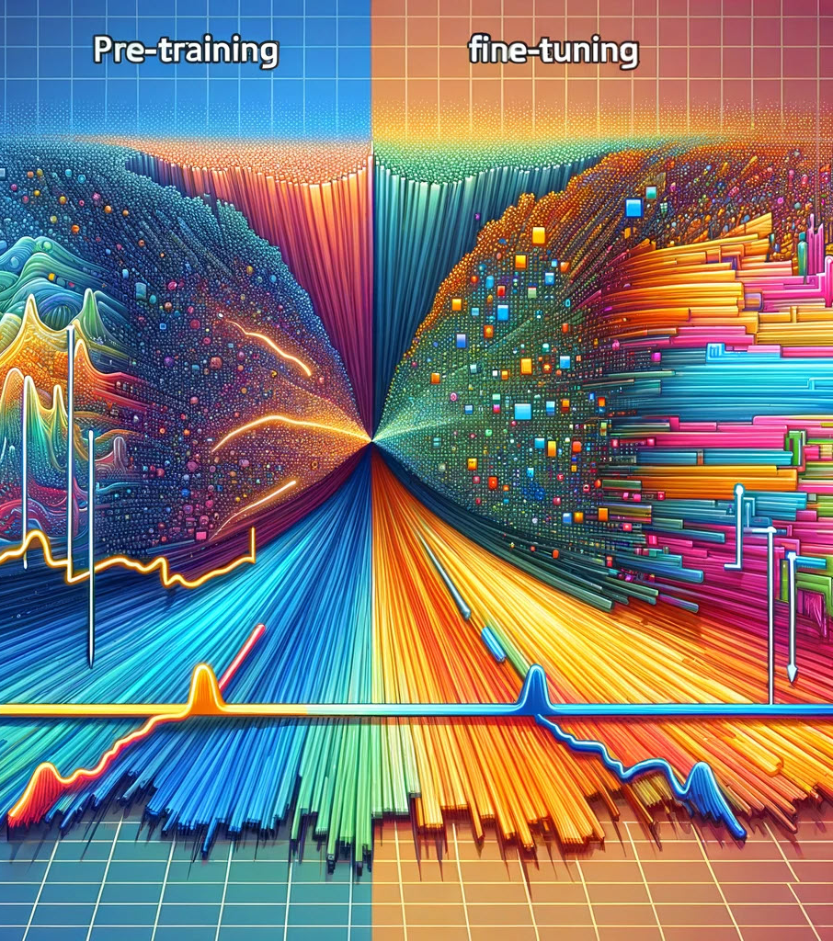
Model Training Processes
Model Training Process
Pre-training
Fine-tuning: Tailoring for specific tasks
Examples
Notes:
Moving on to the model training process for Large Language Models (LLMs), which involves pre-training and fine-tuning
Model Training Process: Training an LLM involves two main steps: pre-training and fine-tuning.
Pre-Training: Pre-training is the first step where the model learns from a massive amount of text data. During this phase, the model tries to predict the next word in a sentence, helping it understand grammar, facts about the world, and some level of reasoning. Think of it like reading a vast library of books to gain general knowledge about language and information. For example, if the model reads sentences like "The cat sat on the...," it learns to predict that "mat" might be the next word.
Fine-Tuning: Fine-tuning is the second step where the model is trained on a smaller, more specific dataset tailored to tasks or industries. This is like taking the general knowledge from the vast library and then focusing on specific subjects, like biology or history, to become an expert in those areas. For instance, a model pre-trained on general text might be fine-tuned with medical texts to help it understand and generate medical information accurately.
Examples to Illustrate:
Pre-Training Example: Imagine you want to become a chef. First, you learn general cooking techniques by reading a variety of cookbooks and practicing different recipes (pre-training). You get a broad understanding of how to cook various dishes.
Fine-Tuning Example: After becoming familiar with general cooking, you decide to specialize in baking. You focus on baking-specific books and practice baking techniques (fine-tuning). Now, you're not just a general chef but a baking expert.

Slide 16

Resources Needed, Part I
Hardware Requirements
High-Performance GPUs: Essential for handling the massive computations required during training. GPUs like NVIDIA's A100 or V100 are commonly used.
Extensive Storage: Petabyte-scale storage solutions are necessary to manage the vast datasets LLMs require.
Powerful Processing Units: High-end CPUs to support the overall system performance and manage data preprocessing and other tasks.
Notes:
Training Large Language Models (LLMs) requires substantial computational resources.
High-performance GPUs are essential as they handle the immense parallel computations needed for processing large datasets efficiently.
Extensive storage solutions, often petabyte-scale, are necessary to keep all that data organized and accessible.
Powerful CPUs also play a crucial role in supporting overall system performance, managing data preprocessing, and other tasks to maintain a smooth training pipeline.

Slide 17

Resources Needed, Part II
Cost Implications
Energy Consumption: Training LLMs is energy-intensive, often leading to significant electricity costs.
Maintenance: Regular upkeep of hardware and software systems to ensure optimal performance.
Ongoing Updates: Continuous improvements and updates to the models, requiring additional computational resources.
Notes:
The cost implications of training LLMs are also significant.
One of the biggest expenses is energy consumption, as running these computations requires a lot of electricity, leading to substantial costs.
Maintenance of hardware and software systems requires regular attention and resources.
Ongoing updates and model improvements demand additional computational resources, further increasing costs.

Slide 18
Resources Needed, Part III
Scalability Considerations
Cloud Computing: Leveraging cloud services to scale resources up or down based on demand.
Cluster Management: Efficiently managing clusters of GPUs and CPUs to maximize resource utilization.
Cost-Effective Solutions: Exploring cost-effective hardware options and energy-efficient practices.ll financial burden.
Notes:
Scalability is a key aspect when discussing computational resources for LLMs.
Cloud computing offers a flexible solution, allowing resources to be scaled up or down based on demand, which helps manage costs and ensures efficient use of resources.
Efficient cluster management of GPUs and CPUs maximizes resource utilization and investment.
Exploring cost-effective hardware options and energy-efficient practices can help reduce the overall financial burden.

Slide 19

Resources Needed, Part IV
Environmental Impact
Energy-Efficient Hardware: Investing in more energy-efficient GPUs and CPUs to reduce carbon footprint.
Sustainable Practices: Implementing green practices in data centers, like using renewable energy sources.
Offset Programs: Participating in carbon offset programs to mitigate the environmental impact.
Notes:
The environmental impact of training LLMs is another important consideration.
Using energy-efficient hardware, such as the latest GPUs and CPUs designed to consume less power, can reduce the carbon footprint.
Implementing sustainable practices in data centers, like using renewable energy sources, is another positive step.
Participating in carbon offset programs can also help mitigate the environmental impact, ensuring that advancements in AI do not come at the cost of the planet.

